Slide 1

Autonomous Ball Catcher
Mobile Robotics Project Report & Progress
SHIVANSH PRATAP SINGH • SIDDHARTH JAIN

Slide 2



Project Overview
Project Goal
Current Status
To design and implement an autonomous mobile robot capable of detecting, tracking, and physically intercepting a moving projectile (ball) in a controlled environment.
Mobile Base: Stable and reliable 4-wheel differential drive chassis established.
Control: Baseline PID controller implemented for precise motion regulation.
Vision: Dual-camera system calibration and triangulation pipeline completed.

Slide 3

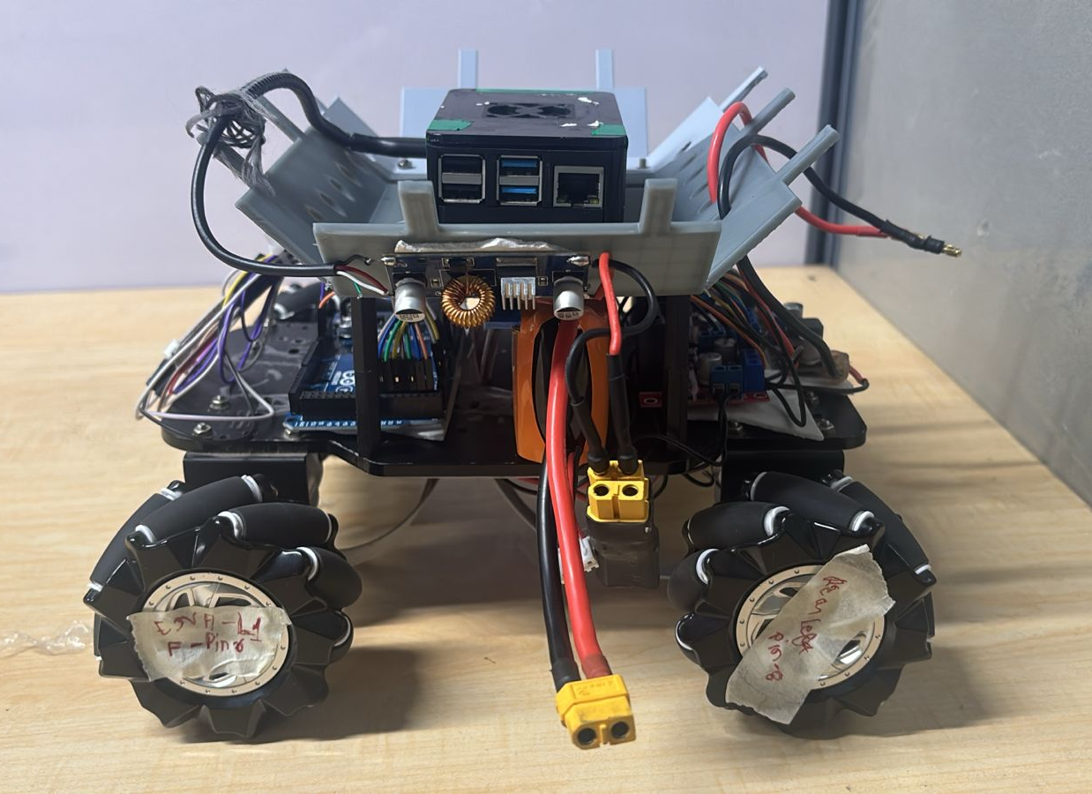
Hardware Architecture
Chassis: 4-Wheel Differential Drive platform ensuring omnidirectional agility.
Planner (High-Level): Raspberry Pi 4B handles trajectory logic and WiFi communication.
Controller (Low-Level): Arduino Mega processes real-time encoder interrupts and motor control.
Actuation: 4x Micro DC12V Geared Motors with 600 PPR Quadrature Encoders.

Slide 4







System Integration
Power Electronics
Real-Time Control
Communication
L298N Dual H-Bridge Motor Driver manages high-current power delivery to the DC motors, interfacing directly with the battery source.
Arduino Mega reads encoder feedback via interrupts to calculate RPM and adjust PWM signals instantly.
USB Serial Connection (9600 baud) links the Raspberry Pi planner to the Arduino controller for directional commands.

Slide 5
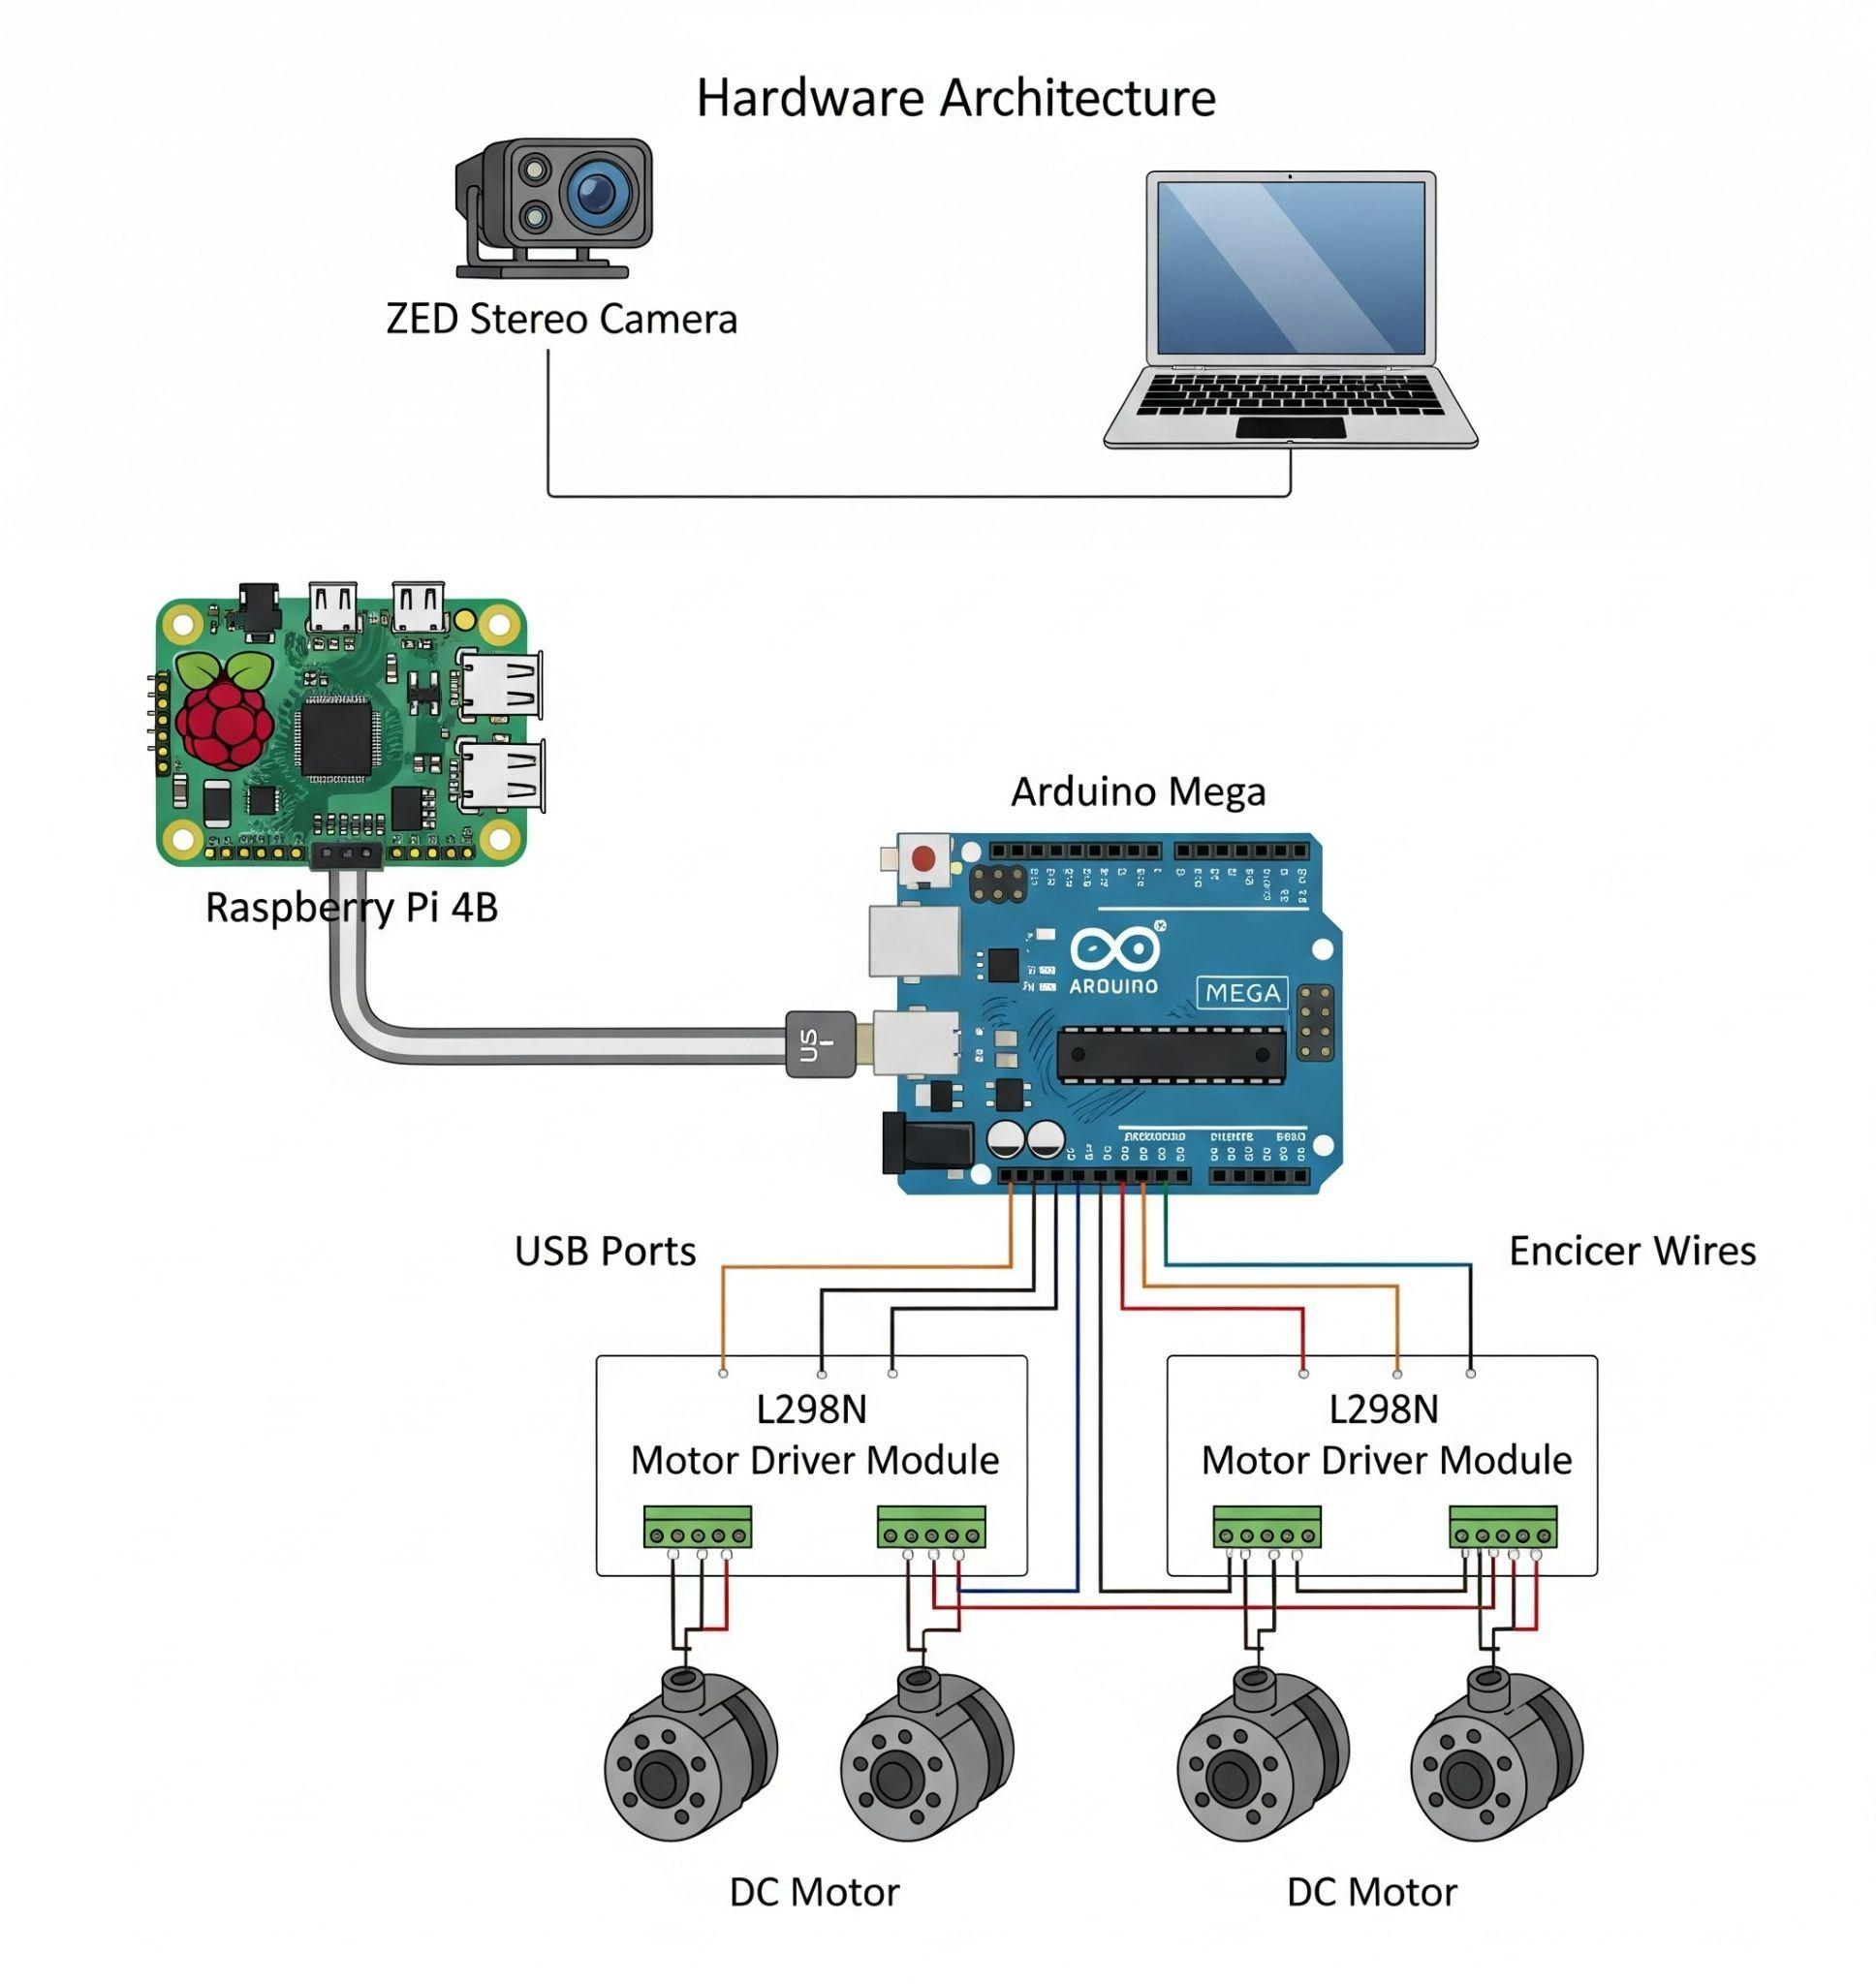
Low-Level Control (PID)
A Proportional-Integral-Derivative (PID) controller is implemented on the firmware to synchronize the four independent wheels.
Tuned Gains
Kp (Proportional): 1.5 - Immediate error correction.
Ki (Integral): 0.5 - Eliminates steady-state error.
Kd (Derivative): 0.1 - Dampens oscillation.
Result: Consistent motor speeds despite mechanical friction or battery voltage variance.

Slide 6

High-Level Navigation
Heading Logic
The navigation script (Python) calculates the heading error ( θ err ) relative to the target.
If θ err > Tolerance : Turn Right ('d')
# Navigation Logic Snippet
If θ err < -Tolerance : Turn Left ('a')
if abs(heading_error) > TOLERANCE: if heading_error > 0: send_command('d') # Right else: send_command('a') # Left else: send_command('w') # Forward
Else: Move Forward ('w')

Slide 7
Performance Benchmarks
Metric | Observed Value | Significance
Max Linear Velocity | ~1.1 m/s | Sufficient speed to intercept objects thrown at moderate velocities.
Command Latency | < 10 ms | Negligible delay ensures real-time responsiveness to vision data.
Motion Stability | High | PID controller successfully eliminates drift, maintaining straight trajectories.
Data collected during Week 1 ground tests verifying drive train limits.

Slide 8
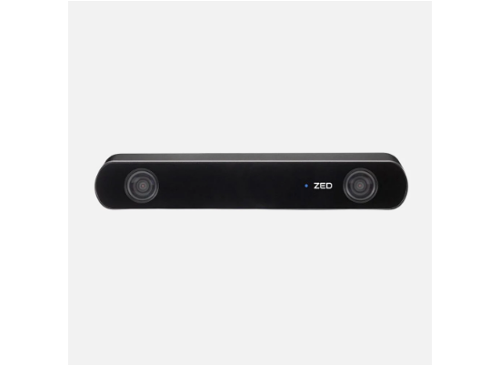

Stereo Vision System
ZED 2i Camera
Utilizes dual lenses to act as independent observers, enabling depth perception through triangulation.
Pinhole Camera Model
Maps a 3D point X to a 2D pixel x via the projection matrix P .
Where K is the Intrinsic Matrix and [ R | t ] represents Extrinsic parameters.

Slide 9

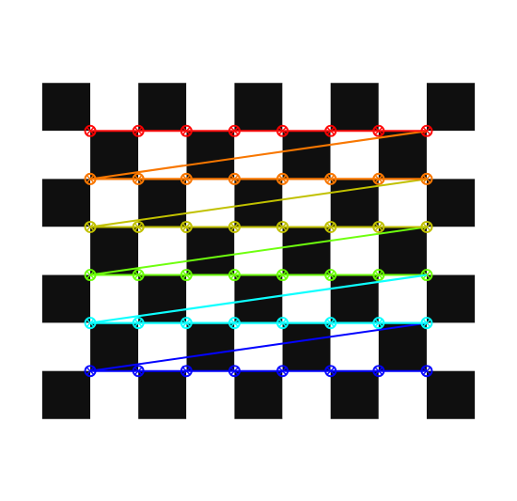
Camera Calibration
Procedure
Intrinsic: Captured checkerboard images to solve for focal lengths ( f x , f y ) and principal points.
Extrinsic: Computed rigid transformation ( R , T ) between left and right lenses.
RMSE Results (Error)
Left Camera | 0.18
Right Camera | 0.19
Stereo System | 0.31

Slide 10
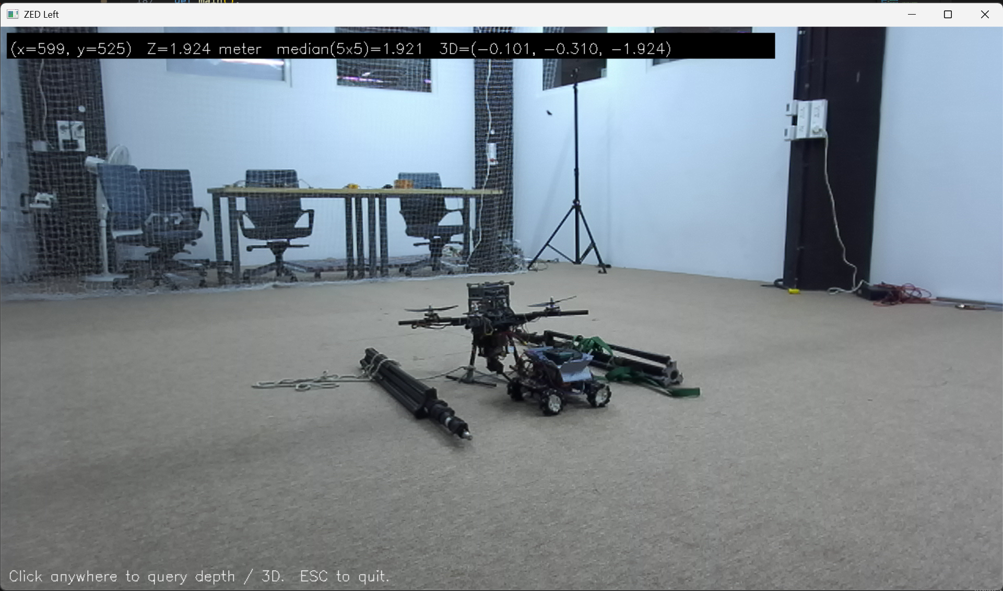
Triangulation (DLT)
We implemented the Direct Linear Transform (DLT) algorithm to reconstruct 3D points from matched 2D pixel observations.
Algorithm
Given projection matrices P 1 and P 2 .
Solve the linear system A X = 0 derived from the cross-product constraint x i × ( P i X ) = 0 .
Solution: Computed via Singular Value Decomposition (SVD), corresponding to the smallest singular value.

Slide 11
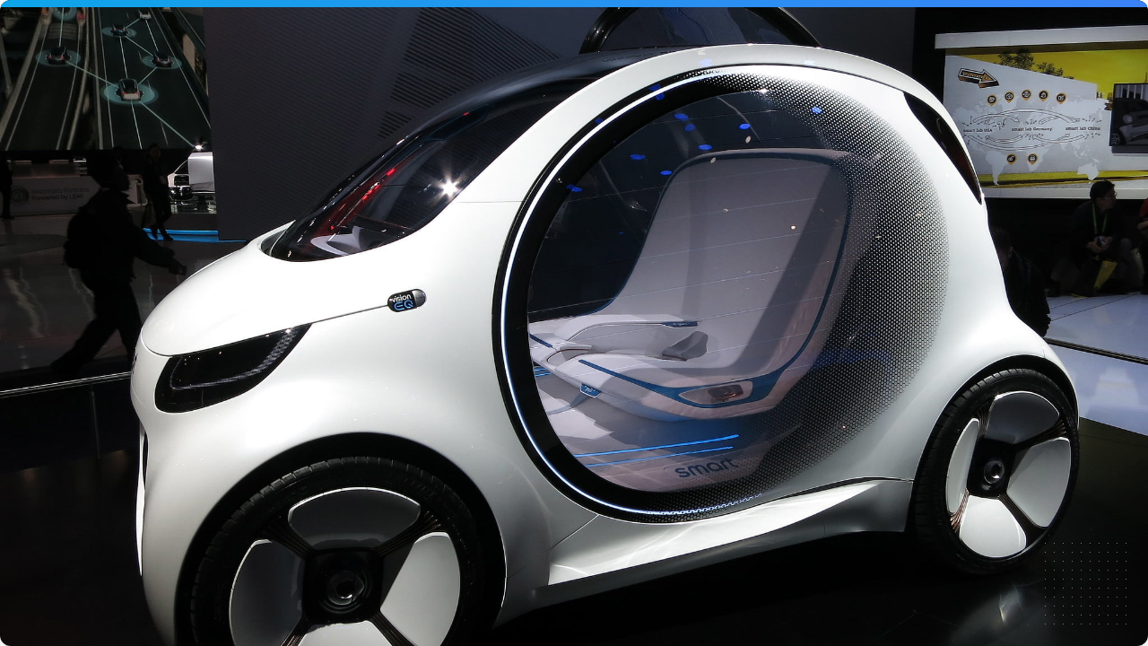

Future Outlook
Status: Platform & Vision Operational
Next Phase: Trajectory Estimation & Predictive Interception

Slide 12
Thank you
Shivansh Pratap Singh (2024702024)
Siddharth Jain (2025701046)

